Slide 1
Reproduction/Asexual and sexual

Slide 2
Asexual Reproduction
It is reproduction involving only one-parent organism with no gamete formation, fertilization and zygote formation. The offspring are identical to their parents (no variation), because parents give their daughter cells by mitosis.

Slide 3
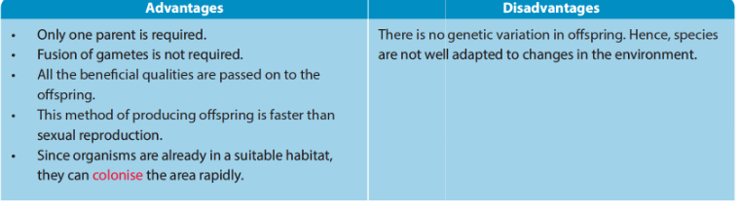
Advantages and disadvantages of asexual reproduction

Slide 4
Examples of asexual reproduction

Slide 5
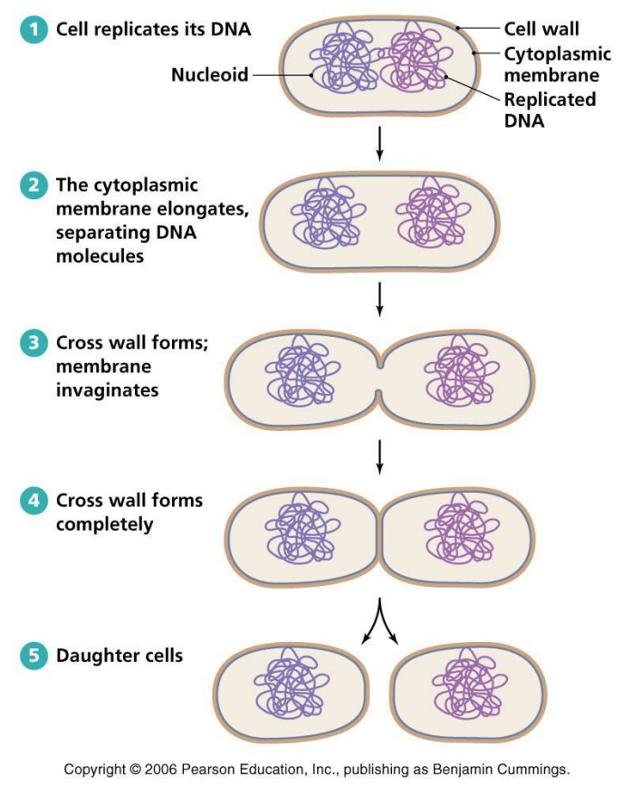
A reproduction in bacteria (Binary Fission)
• Bacteria The type of division is Binary fission. When conditions (food, water, temperature, space) are suitable for reproduction, one bacterium divides into two cells (identical daughter bacteria).

Slide 6
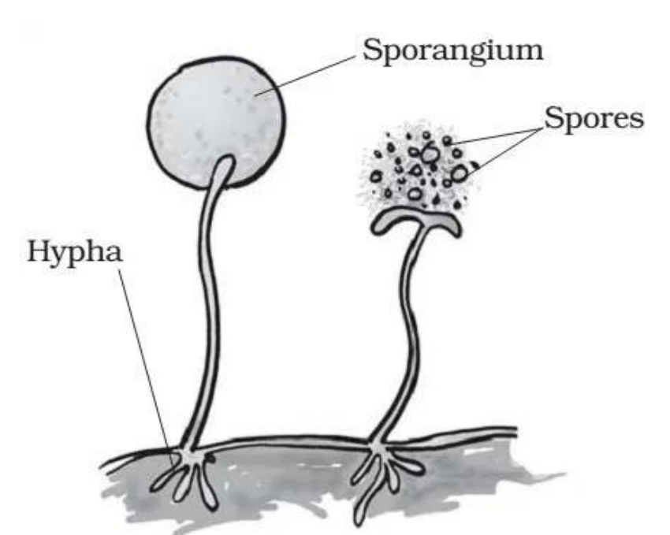
b. fungi by spore formation
The up right hyphae are those responsible for reproduction. A swollen is formed at the tip of the up right hypha, which is called sporangium. The cytoplasm divides into small spores each containing many nuclei and little cytoplasm. At maturity the sporangium ruptures releasing the spores. Spores are carried by air current onto new suitable medium. Each spore then grows into a new fungus.

Slide 7
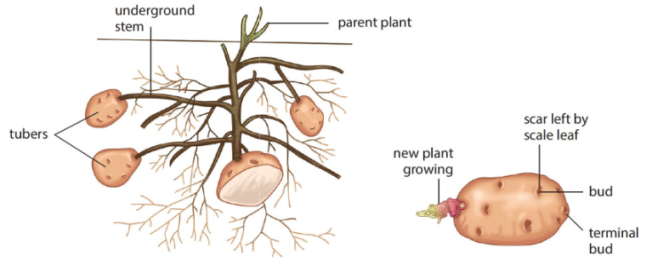
C. plants by tuber formation
• Rhizomes are underground lateral stems.
• They grow from the base of a potato stem under the surface of the ground.
• Sucrose in the green leaves is translocated along the phloem to the tips of these rhizomes.
• Sucrose is converted into starch and stored.
• The tips swell with stored food, starch to form tubers.
• Buds in tubers grow into new potato plant, by forming new shoot and roots.
Note: asexual reproduction in plants is also known as vegetative propagation.

Slide 8
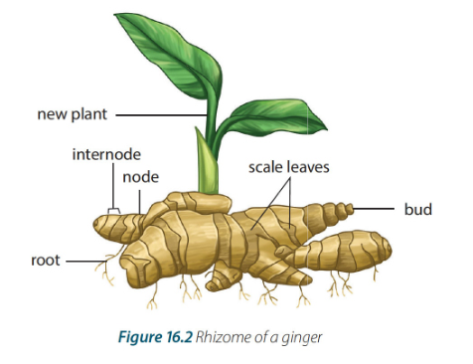
By rhizomes
It is underground storage stem
It bears scale leaves and buds
Each bud can grow into new plant

Slide 9
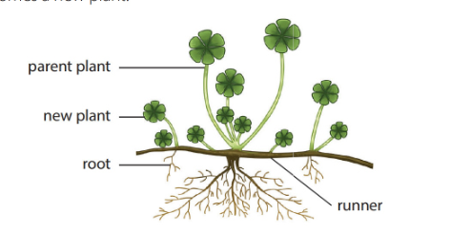
By runners
It is a slender shoot that arises from the bud in the parent plant.
It grows horizontally over the surface of the soil.
Buds develop along its length
Each bud develops roots and leaves and becomes a new plant.

Slide 10
Sexual reproduction
It is reproduction involving two parents. Parents have specialized reproductive organs where gametes are produced by meiosis. There is fertilization, zygote formation, and variation, so the offspring are similar but not identical to their parents.

Slide 11
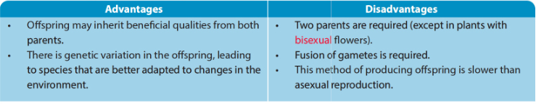
Advantages and disadvantages of sexual reproduction

Slide 12
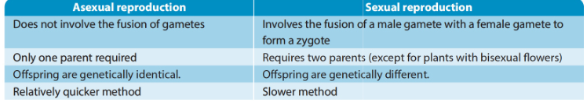
Asexual VS sexual

